Slide 1






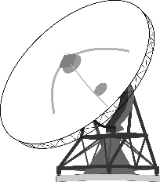


GNAT Client Server Scenario
WAN1
WAN2
GNAT
Bonding Server
Command Center
User Device
Network
Administrator

Slide 2
GNAT Client-Client Scenario
WAN1
GNAT
WAN2
GNAT
User Device
User Device
Bonding Server
Command Center
Network
Administrator

Slide 3
Software Description
Network troubleshooting
Distribute between classified and unclassified connections
Monitor system and connection health
Change network settings
Set application priorities

Slide 4
User Description
It is assumed the user is a network engineer and has detailed understanding of network IP protocols and packet flow.
User must have enough mission and networking knowledge to monitor mission success and node health.
The user will have the ability to change network flow, overriding pre-populated DRA needs.

